Slide 1

Minor Project Presentation on Air quality analysis and prediction using Machine Learning
Submitted By:
Kanchan Thapa [21075415]
Manita Joshi [21075417]
Sangita Bhattarai [21075433]
Sunita Bashyal [21075439]
Submitted to
Department of Computer and IT engineering
Pokhara University
Everest Engineering College
Sanepa-2,Lalitpur
25th February

Slide 2
Table of Contents
Introduction
Problem Statement
Objective
Literature Review
Methodology
Data Used
Correlation Heatmap
Time Series Analysis
Models Used
Evaluation Metrices
Models Evaluation Result
Residual Test
Feature Importance
Conclusion
References

Slide 3
Introduction
Prediction of air quality
Key pollutants include PM2.5, Temperature, Pressure, Humidity, Dew point, Precipitation, etc.
Pollution harms human health and contributes to global warming and acid rain.
Machine learning, a method of data analysis that automates analytical model.
Supervised, unsupervised and reinforcement machine learning.

Slide 4
Problem Statement
Understanding air quality requires tracing pollutants and analyzing patterns.
Traditional model ,costly and time-consuming.
Machine learning automates data analysis, surpassing traditional systems.

Slide 5
Objective
To analyze the factors affecting PM2.5 and finding the best predictive model for PM2.5.

Slide 6
Literature Review
Suprateek Halsana predicted the Air Quality Index (AQI) by analyzing pollutant concentrations and weather conditions.
Bozdag et al. used machine learning (LASSO, SVR, RF) to predict PM10 levels at a station in Ankara, based on data from six stations and visualized with GIS.
Maltare et al. compared SARIMA, SVM, and LSTM to predict the air quality index in Ahmedabad, emphasizing the SVM with an RBF kernel.
CR et al. used logistic regression to detect pollution and autoregression to predict future PM2.5 levels based on daily atmospheric conditions.

Slide 7
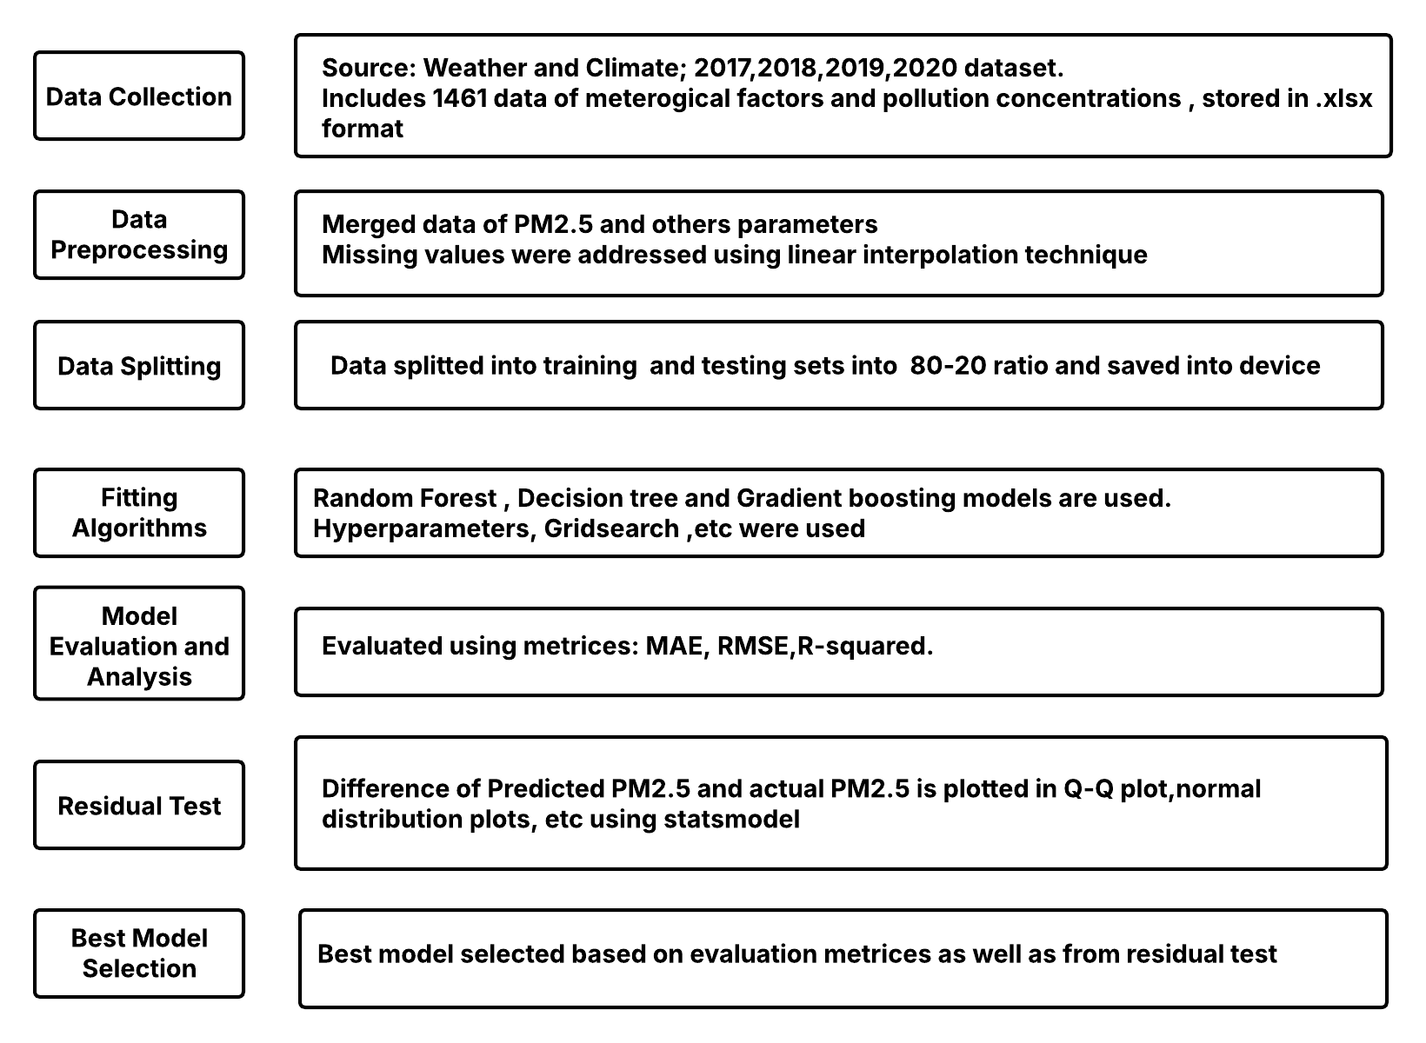
Methodology
Figure: Block Diagram

Slide 8
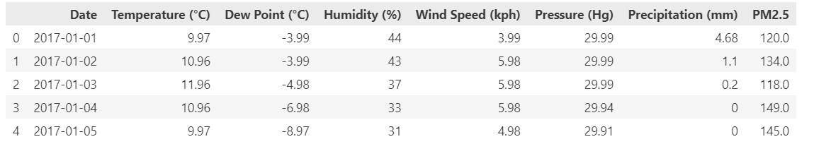
Data Used

Slide 9
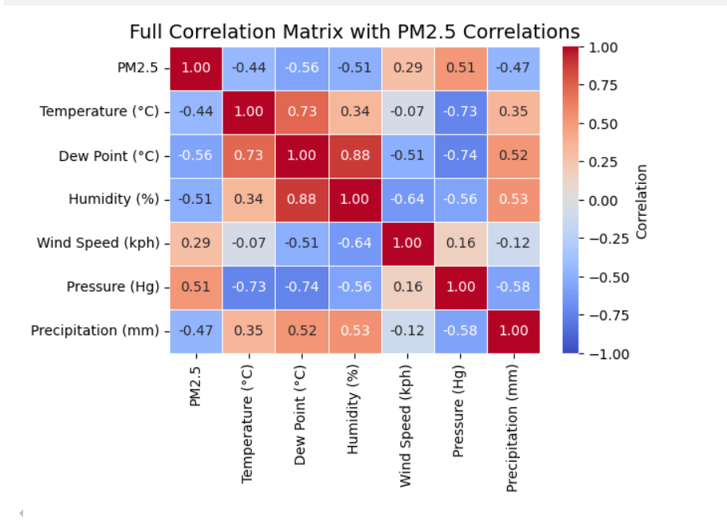
Correlation Heatmap

Slide 10
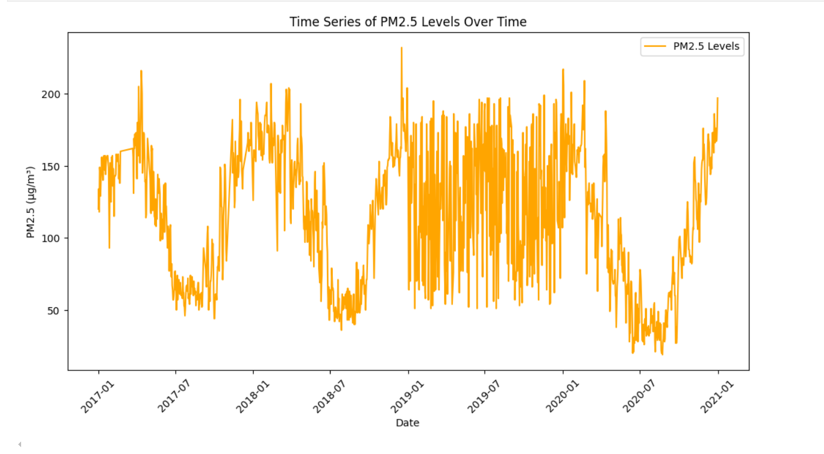
Time Series Analysis

Slide 11
Models Used
Decision Tree Regressor
A flowchart like process that splits data based on conditions.
Used for both classification and regression.
Random Forest Regressor
It combines multiple Decision Trees to boost accuracy and reduce overfitting.
Used to train the model.
Gradient Boosting Regressor
An advanced ML algorithm used for predictive modeling.
Builds tree sequentially and each tree corrects the errors of previous one.

Slide 12
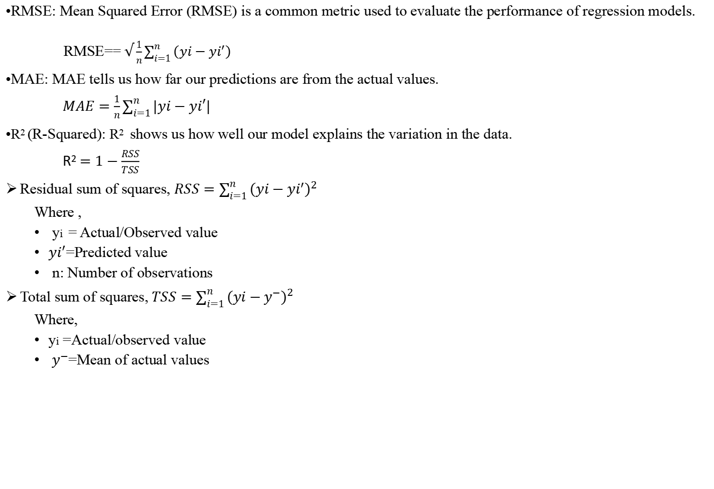
Evaluation Metrices
•RMSE: Mean Squared Error (RMSE) is a common metric used to evaluate the performance of regression models.
RMSE== $√\frac{1}{n}\sum_{i=1}^{n}{\left(yi−yi^{′}\right)}$
•MAE: MAE tells us how far our predictions are from the actual values.
$MAE=\frac{1}{n}\sum_{i=1}^{n}{|yi−yi′|}$
•R² (R-Squared): R² shows us how well our model explains the variation in the data.
R² $=1−\frac{RSS}{TSS}$
Residual sum of squares, $RSS=\sum_{i=1}^{n}{{(yi−yi^{′})}^{2}}$
Where ,
yi​ = Actual/Observed value
$yi^{′}$=Predicted value
n: Number of observations
Total sum of squares,$TSS=\sum_{i=1}^{n}{{(yi−y^{−})}^{2}}$
Where,
yi =Actual/observed value
${ y}^{−}$=Mean of actual values

Slide 13
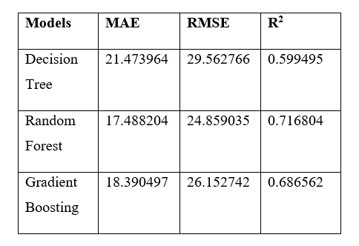
Models Evaluation Result

Slide 14
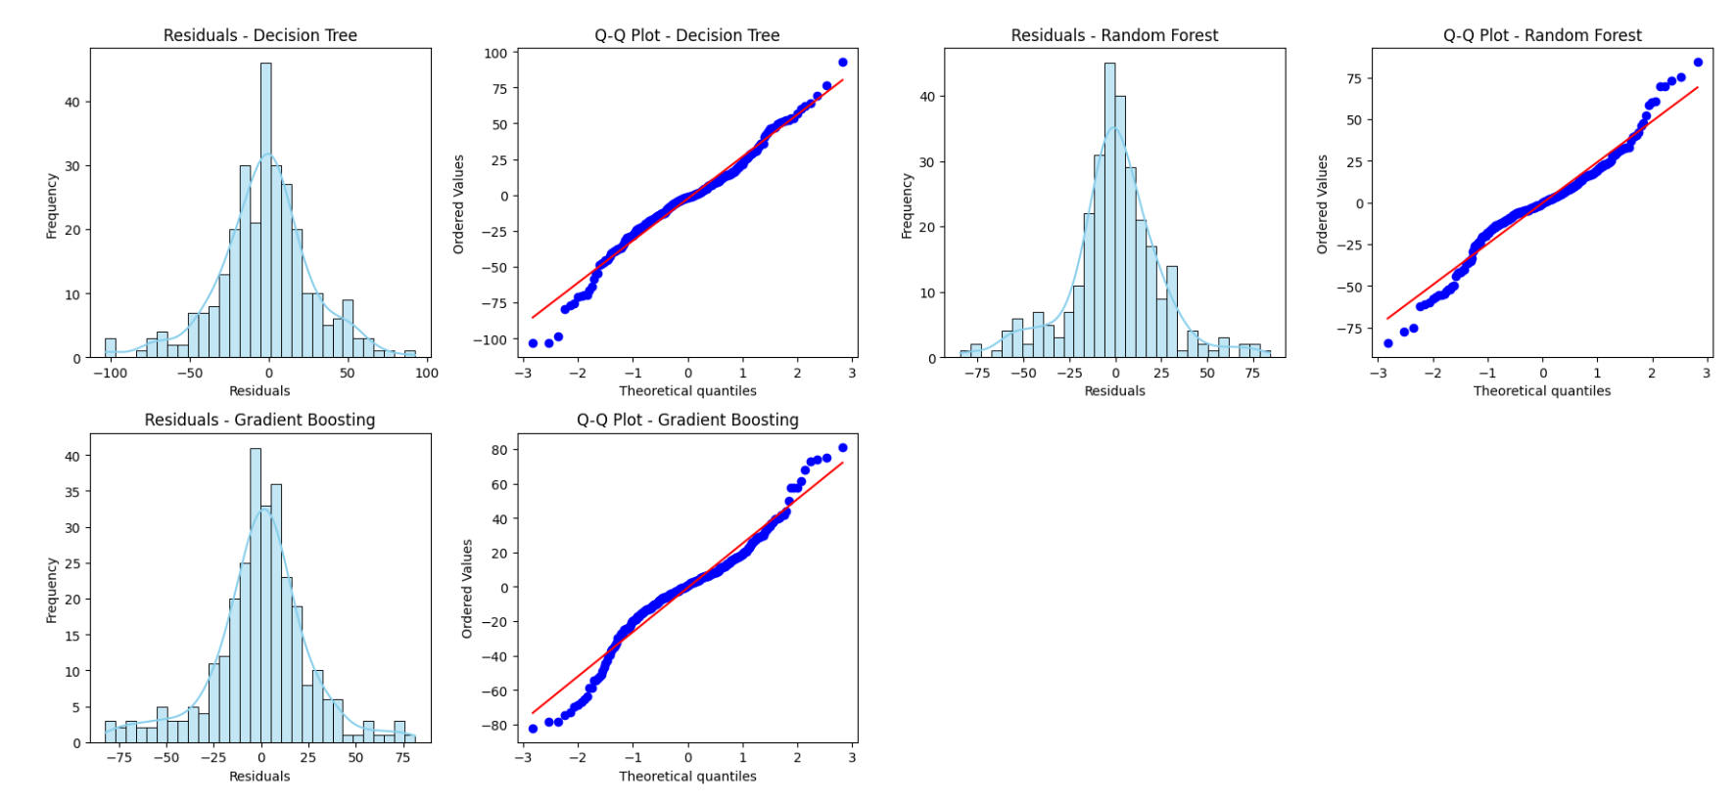
Residual Test

Slide 15
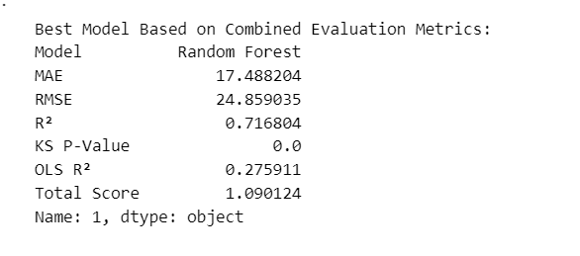
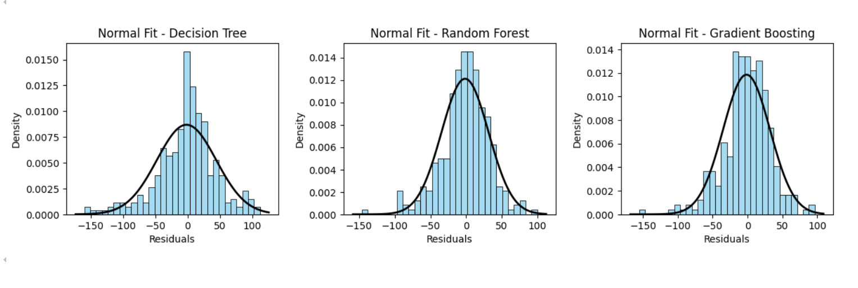

Slide 16
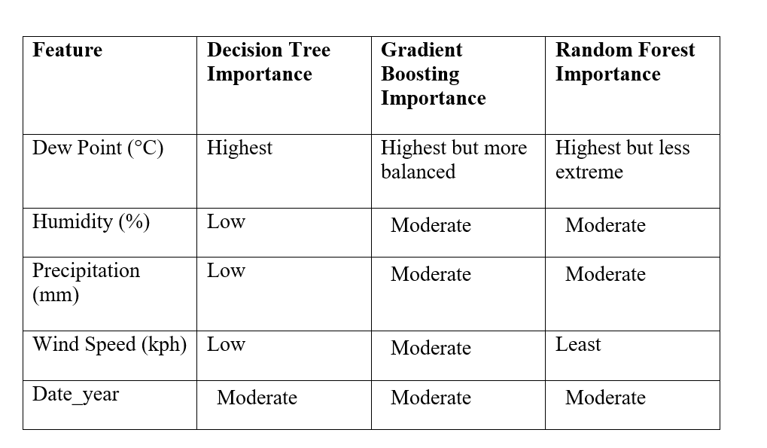
Feature importance

Slide 17
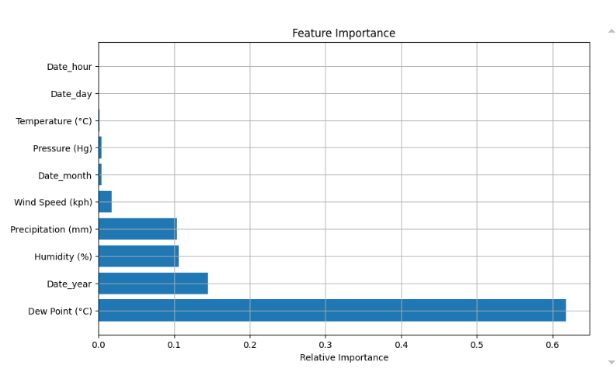
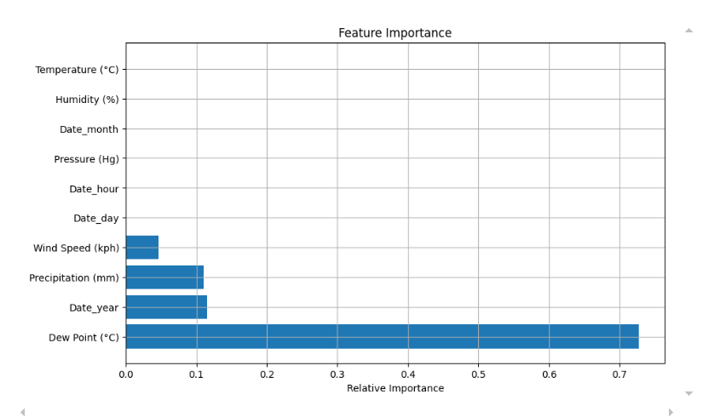
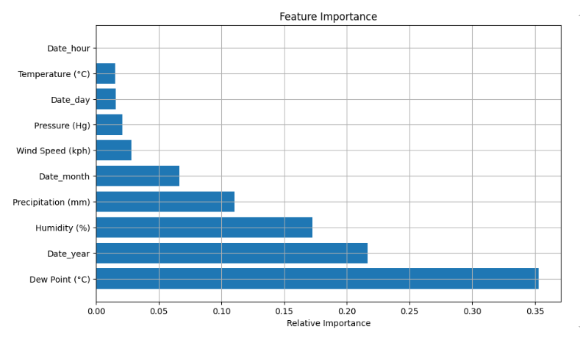
Random Forest
Decision Tree
Gradient Boosting

Slide 18
Conclusion
Air quality prediction is challenging due to unpredictable pollutants.
Decision tree, Random forest, Gradient boosting used to predict PM2.5.
RMSE, MAE, and R² used for model evaluation.
Random forest turned out to be best model with MAE =17.48 , RMSE = 24.84, R-squared =0.71.
Residual analysis further validated Random forest as best model.
Random forest model is the best model for PM2.5 prediction , excelling in metrices and residual analysis.

Slide 19
References
[1] K. Kumar and B. P. Pande, “Air pollution prediction with machine learning: a case study of Indian cities,” Int. J. Environ. Sci. Technol., vol. 20, no. 5, pp. 5333–5348, May 2023, doi: 10.1007/s13762-022-04241-5.
[2] C. Aditya, C. R. Deshmukh, D. Nayana, and P. G. Vidyavastu, “Detection and prediction of air pollution using machine learning models,” Int. J. Eng. Trends Technol. IJETT, vol. 59, no. 4, pp. 204–207, 2018.
[3] S. Halsana, “Air Quality Prediction Model using Supervised Machine Learning Algorithms,” Int. J. Sci. Res. Comput. Sci. Eng. Inf. Technol., pp. 190–201, Jul. 2020, doi: 10.32628/CSEIT206435.

Slide 20
[4] A. Bozdağ, Y. Dokuz, and Ö. B. Gökçek, “Spatial prediction of PM10 concentration using machine learning algorithms in Ankara, Turkey,” Environ. Pollut., vol. 263, p. 114635, Aug. 2020, doi: 10.1016/j.envpol.2020.114635.
[5] N. N. Maltare and S. Vahora, “Air Quality Index prediction using machine learning for Ahmedabad city,” Digit. Chem. Eng., vol. 7, p. 100093, Jun. 2023, doi: 10.1016/j.dche.2023.100093.
[6] “Aqi To Print | PDF | Regression Analysis | Air Pollution.” Accessed: Dec. 26, 2024. [Online]. Available: https://www.scribd.com/document/510300340/Aqi-to-Print

Slide 21
Thank you

